Slide 1



Slide 2


Team Alpha From 9th G Presenting Here
ARITHMETIC
PROGRESSION
JOURNEY OF NUMBERS WITH STORIES

Slide 3

ARITHMETIC PROGRESSION
TEAM MEMBERS
Pratham
Shabdansh
Ayushi
Laxmi
Akshsara
Arman

Slide 4
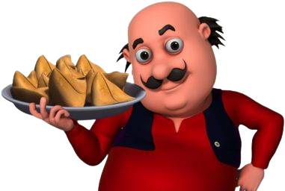
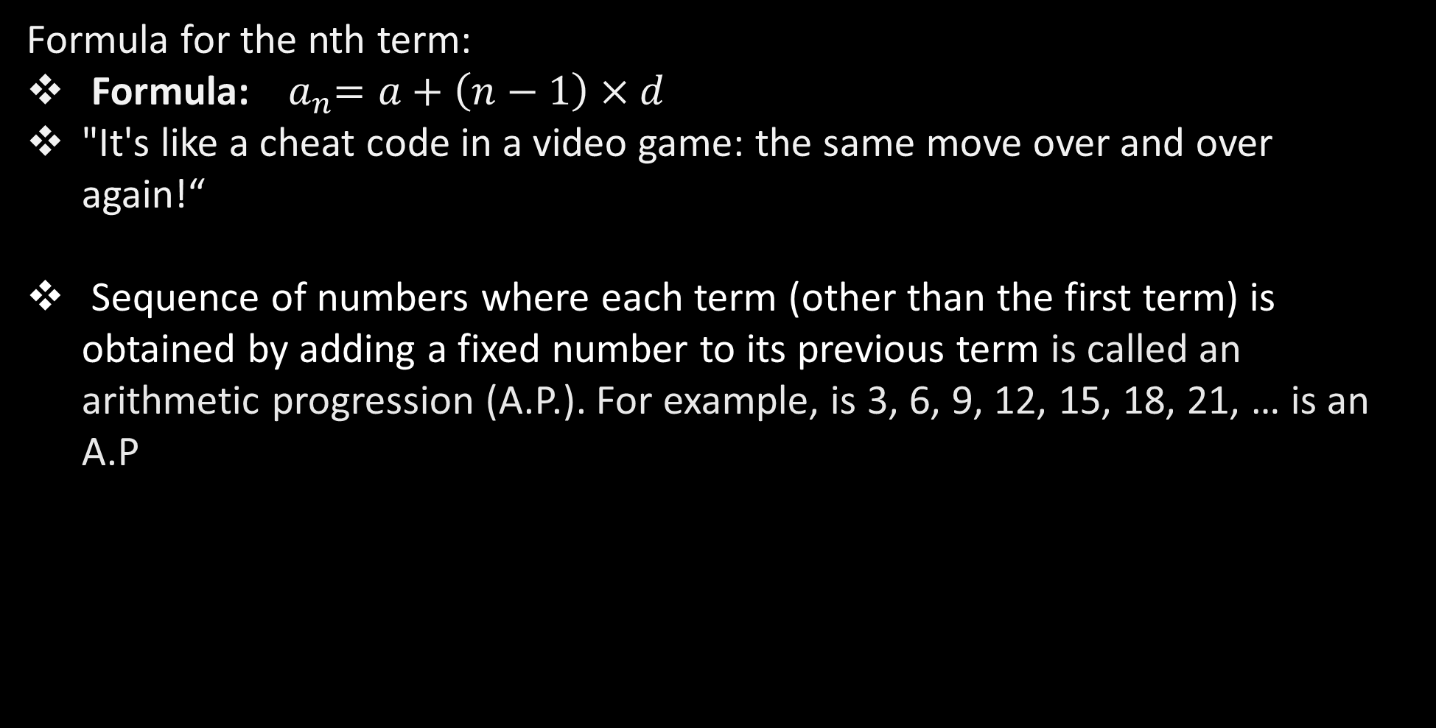
The Basic Of AP
What Exactly Is Arithmetic Progression?
Imagine a row of samosa increasing by the same number each time you add a new one to the plate.
In other words, the first samosa is 1, the second is 2 with 3 chutney more, and the third is 5 with even more sprinkles!
Over the days, your samosa stash grows like this:
Day 1: 3 samosas
Day 2: 5 samosas (3 + 2)
Day 3: 7 samosas (5 + 2)
Day 4: 9 samosas (7 + 2)
...and so on
Formula for the nth term:
Formula:${ a}_{n}=a+\left(n−1\right)×d$
"It's like a cheat code in a video game: the same move over and over again!“
Sequence of numbers where each term (other than the first term) is obtained by adding a fixed number to its previous term is called an arithmetic progression (A.P.). For example, is 3, 6, 9, 12, 15, 18, 21, … is an A.P

Slide 5
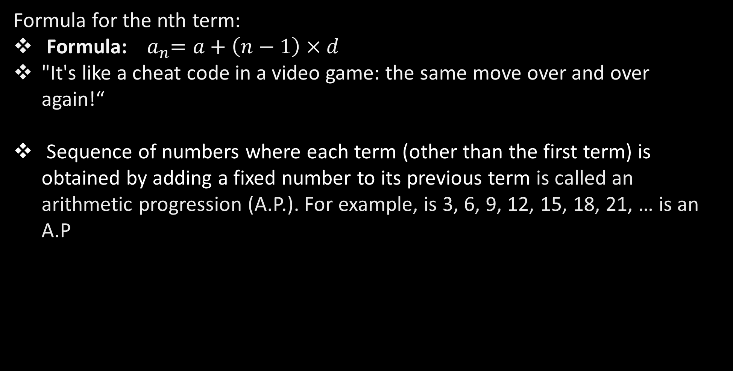

Ingredients
What Exactly Is Arithmetic Progression?
The Basic Of AP
Imagine a row of samosa increasing by the same number each time you add a new one to the plate.
In other words, the first samosa is 1, the second is 2 with 3 chutney more, and the third is 5 with even more sprinkles!
Over the days, your samosa stash grows like this:
Day 1: 3 samosas
Day 2: 5 samosas (3 + 2)
Day 3: 7 samosas (5 + 2)
Day 4: 9 samosas (7 + 2)
...and so on
Formula for the nth term:
Formula:${ a}_{n}=a+\left(n−1\right)×d$
"It's like a cheat code in a video game: the same move over and over again!“
Sequence of numbers where each term (other than the first term) is obtained by adding a fixed number to its previous term is called an arithmetic progression (A.P.). For example, is 3, 6, 9, 12, 15, 18, 21, … is an A.P
While making maggie we need maggie masala and maggie ; just like that while creating ARTHiMETIC PROGRESSION we need 2 ingredients :-
First Term ($a_{1}$)
Common Difference ($d)$

Slide 6

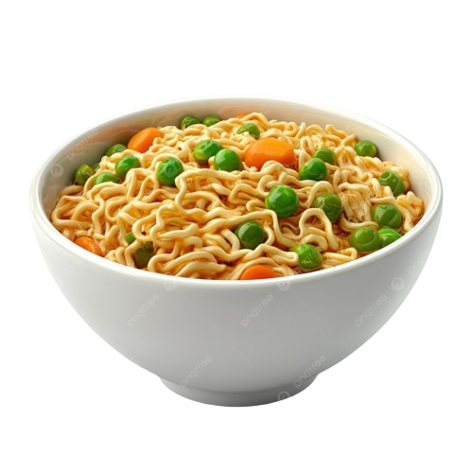




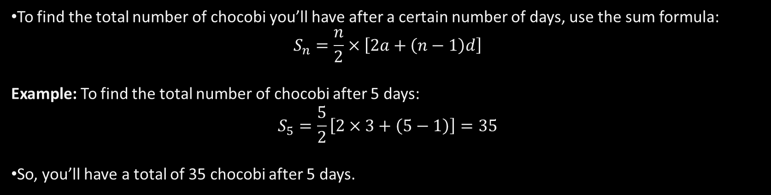
Sum To The $n^{th}$ Term
The Basic Of AP
Ingredients
Formula for the nth term:
Formula:${ a}_{n}=a+\left(n−1\right)×d$
"It's like a cheat code in a video game: the same move over and over again!“
Sequence of numbers where each term (other than the first term) is obtained by adding a fixed number to its previous term is called an arithmetic progression (A.P.). For example, is 3, 6, 9, 12, 15, 18, 21, … is an A.P
While making maggie we need maggie masala and maggie ; just like that while creating ARTHiMETIC PROGRESSION we need 2 ingredients :-
First Term ($a_{1}$)
Common Difference ($d)$
To find the total number of chocobi you’ll have after a certain number of days, use the sum formula:
$$S_{n}=\frac{n}{2}×\left[2a+\left(n−1\right)d\right]$$
Example: To find the total number of chocobi after 5 days:
$$S_{5}=\frac{5}{2}\left[2×3+\left(5−1\right)\right]=35$$
So, you’ll have a total of 35 chocobi after 5 days.
By that $a_{2}−a_{1}=a_{3}−a_{2}=d$

Slide 7





MONEY TALKS
Sum To The $n^{th}$ Term
Ingredients
While making maggie we need maggie masala and maggie ; just like that while creating ARTHiMETIC PROGRESSION we need 2 ingredients :-
First Term ($a_{1}$)
Common Difference ($d)$
To find the total number of chocobi you’ll have after a certain number of days, use the sum formula:
$$S_{n}=\frac{n}{2}×\left[2a+\left(n−1\right)d\right]$$
Example: To find the total number of chocobi after 5 days:
$$S_{5}=\frac{5}{2}\left[2×3+\left(5−1\right)\right]=35$$
So, you’ll have a total of 35 chocobi after 5 days.
By that $a_{2}−a_{1}=a_{3}−a_{2}=d$

Slide 8

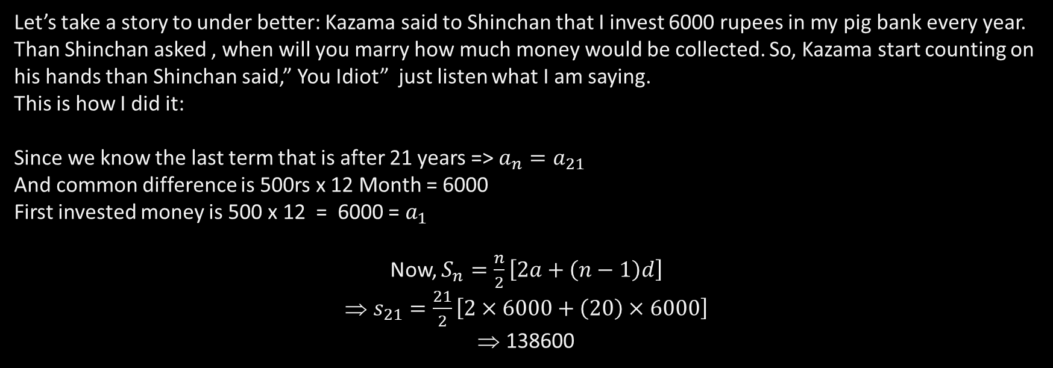
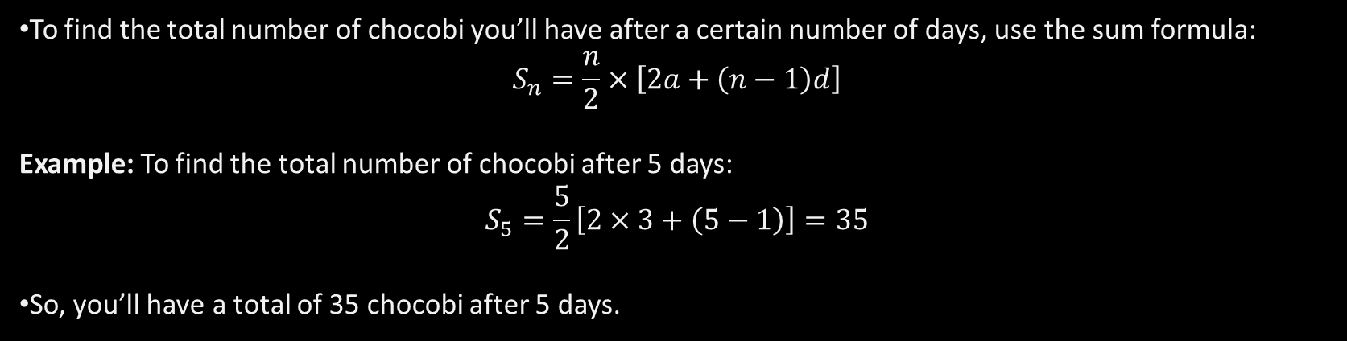

Properties of ARTHMETIC PROGRESSION
MONEY TALKS
Sum To The $n^{th}$ Term
Let’s take a story to under better: Kazama said to Shinchan that I invest 6000 rupees in my pig bank every year. Than Shinchan asked , when will you marry how much money would be collected. So, Kazama start counting on his hands than Shinchan said,” You Idiot” just listen what I am saying.
This is how I did it:
Since we know the last term that is after 21 years => $a_{n}=a_{21}$
And common difference is 500rs x 12 Month = 6000
First invested money is 500 x 12 = 6000 = $a_{1}$
Now, $S_{n}=\frac{n}{2}\left[2a+\left(n−1\right)d\right]$
$s_{21}=\frac{21}{2}\left[2×6000+\left(20\right)×6000\right]$
138600
To find the total number of chocobi you’ll have after a certain number of days, use the sum formula:
$$S_{n}=\frac{n}{2}×\left[2a+\left(n−1\right)d\right]$$
Example: To find the total number of chocobi after 5 days:
$$S_{5}=\frac{5}{2}\left[2×3+\left(5−1\right)\right]=35$$
So, you’ll have a total of 35 chocobi after 5 days.

Slide 9

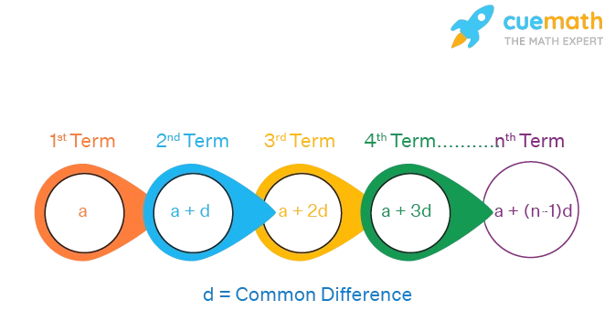
Properties of ARTHMETIC PROGRESSION
Sum To The $n^{th}$ Term
MONEY TALKS
To find the total number of chocobi you’ll have after a certain number of days, use the sum formula:
$$S_{n}=\frac{n}{2}×\left[2a+\left(n−1\right)d\right]$$
Example: To find the total number of chocobi after 5 days:
$$S_{5}=\frac{5}{2}\left[2×3+\left(5−1\right)\right]=35$$
So, you’ll have a total of 35 chocobi after 5 days.
The difference between consecutive term is always constant.
The sequence can be increasing, decreasing or constant depending on the common difference d.
The sum of terms equidistant from the beginning and end of an AP is constant.

Slide 10
A Question for you:-
Properties of ARTHMETIC PROGRESSION
Sum To The $n^{th}$ Term
Q.1 Sum of all numbers from 1 to 100.
To find the total number of chocobi you’ll have after a certain number of days, use the sum formula:
$$S_{n}=\frac{n}{2}×\left[2a+\left(n−1\right)d\right]$$
Example: To find the total number of chocobi after 5 days:
$$S_{5}=\frac{5}{2}\left[2×3+\left(5−1\right)\right]=35$$
So, you’ll have a total of 35 chocobi after 5 days.
A. 555
C. 5555
B. 5050
D. 5100

Slide 11
A Question for you:-
Sum To The $n^{th}$ Term
Q.1 Sum of all numbers from 1 to 100.
To find the total number of chocobi you’ll have after a certain number of days, use the sum formula:
$$S_{n}=\frac{n}{2}×\left[2a+\left(n−1\right)d\right]$$
Example: To find the total number of chocobi after 5 days:
$$S_{5}=\frac{5}{2}\left[2×3+\left(5−1\right)\right]=35$$
So, you’ll have a total of 35 chocobi after 5 days.
A. 555
C. 5555
B. 5050
D. 5100

Slide 12

BINDING UP
Sum To The $n^{th}$ Term
Arithmetic Progression isn't just a mathematical concept; it's a reflection of life's steady progress and incremental growth. Each term in an AP builds upon the previous one, reminding us that small, consistent steps can lead to significant achievements. Whether it's saving money, learning a new skill, or improving our daily habits, the principles of AP show us that persistence and regular effort are key to success.
To find the total number of chocobi you’ll have after a certain number of days, use the sum formula:
$$S_{n}=\frac{n}{2}×\left[2a+\left(n−1\right)d\right]$$
Example: To find the total number of chocobi after 5 days:
$$S_{5}=\frac{5}{2}\left[2×3+\left(5−1\right)\right]=35$$
So, you’ll have a total of 35 chocobi after 5 days.

Slide 13

Sum To The $n^{th}$ Term
To find the total number of chocobi you’ll have after a certain number of days, use the sum formula:
$$S_{n}=\frac{n}{2}×\left[2a+\left(n−1\right)d\right]$$
Example: To find the total number of chocobi after 5 days:
$$S_{5}=\frac{5}{2}\left[2×3+\left(5−1\right)\right]=35$$
So, you’ll have a total of 35 chocobi after 5 days.

